Slide 1

For a Synodal Church
Communion, Participation, Mission

Slide 2
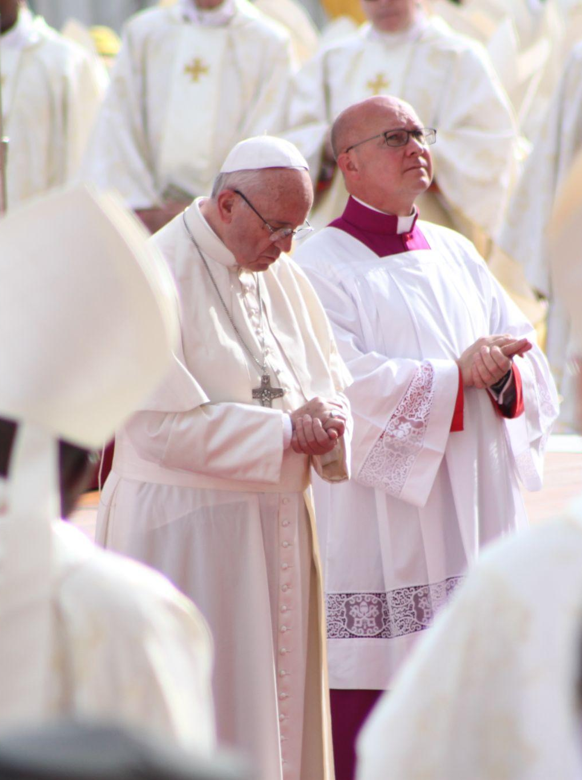
Together, listening to the
Holy Spirit, let us be led by God
We stand before You, Holy Spirit,
as we gather together in Your name.
With You alone to guide us,
make Yourself at home in our hearts; Teach us the way we must go
and how we are to pursue it.
We are weak and sinful;
do not let us promote disorder.
Do not let ignorance
lead us down the wrong path
nor partiality influence our actions.
Let us find in You our unity
so that we may journey together
to eternal life and not stray
from the way of truth and what is right.
All this we ask of You, who are at work in every place and time, in the communion of the Father and the Son, forever and ever. Amen.

Slide 3
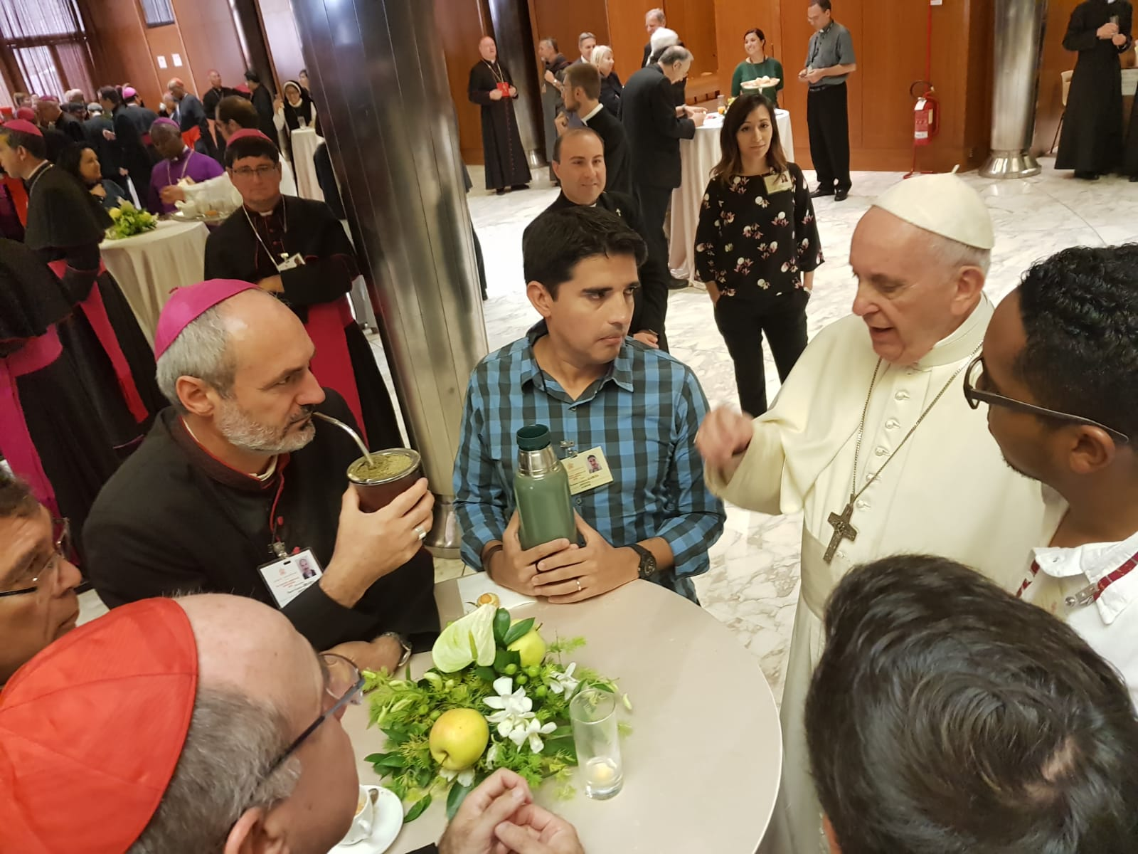
“Synodality is the way of being the Church today according to the will of God, in a dynamic of discerning and listening together to the voice of the Holy Spirit.”
Pope Francis

Slide 4
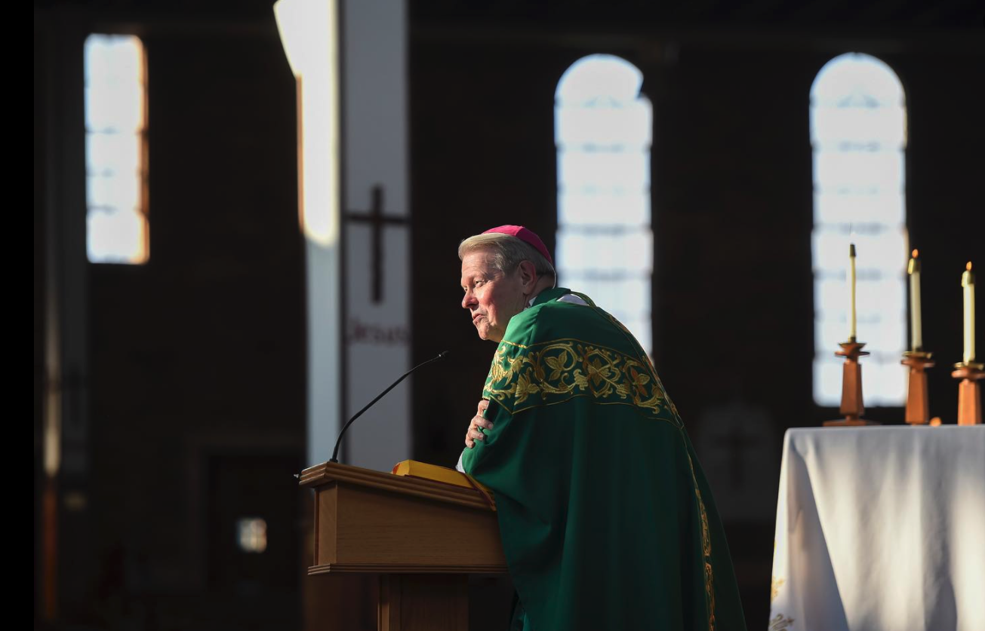
“We are all part
of the Body of Christ.
Everyone has a role
to play. Everyone
has a place.”
— Bishop Edward B. Scharfenberger

Slide 5
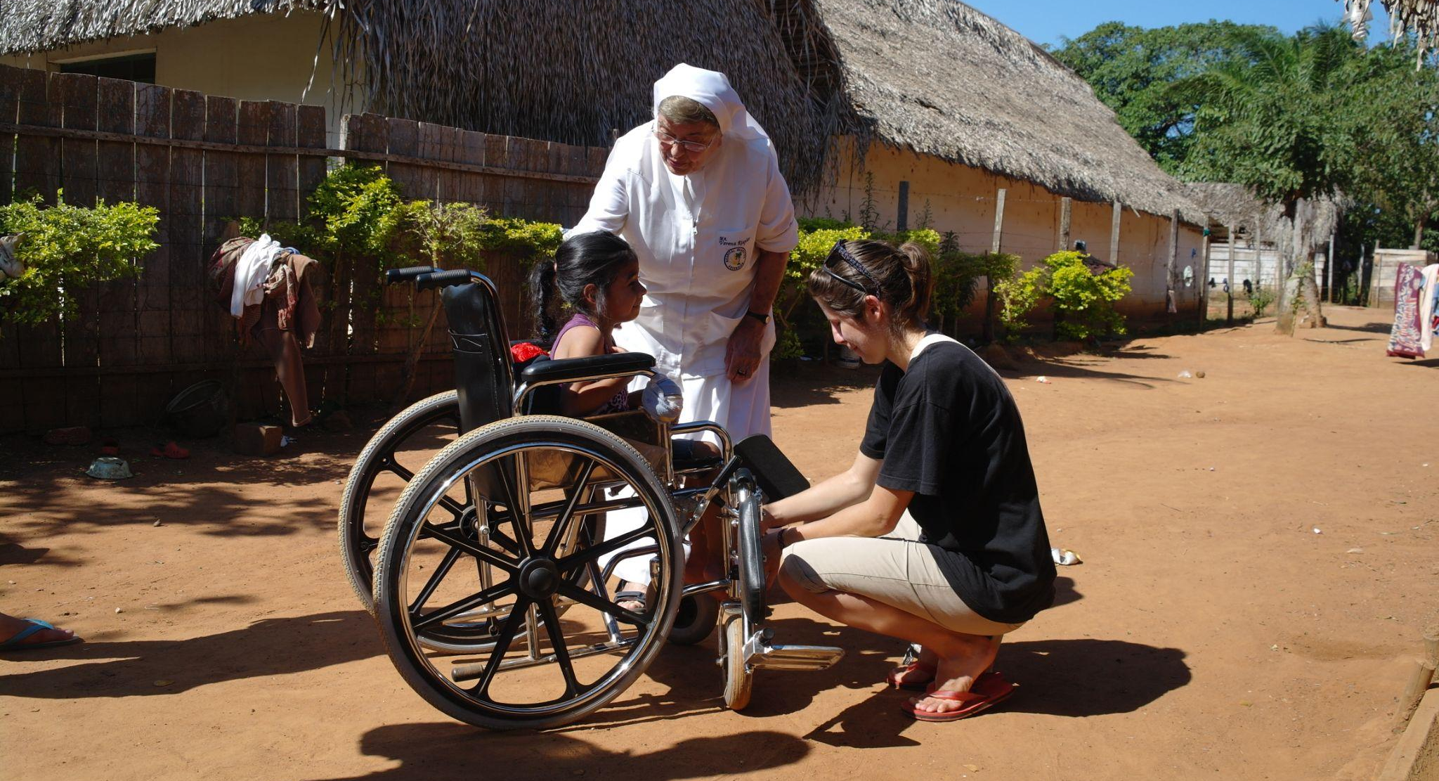
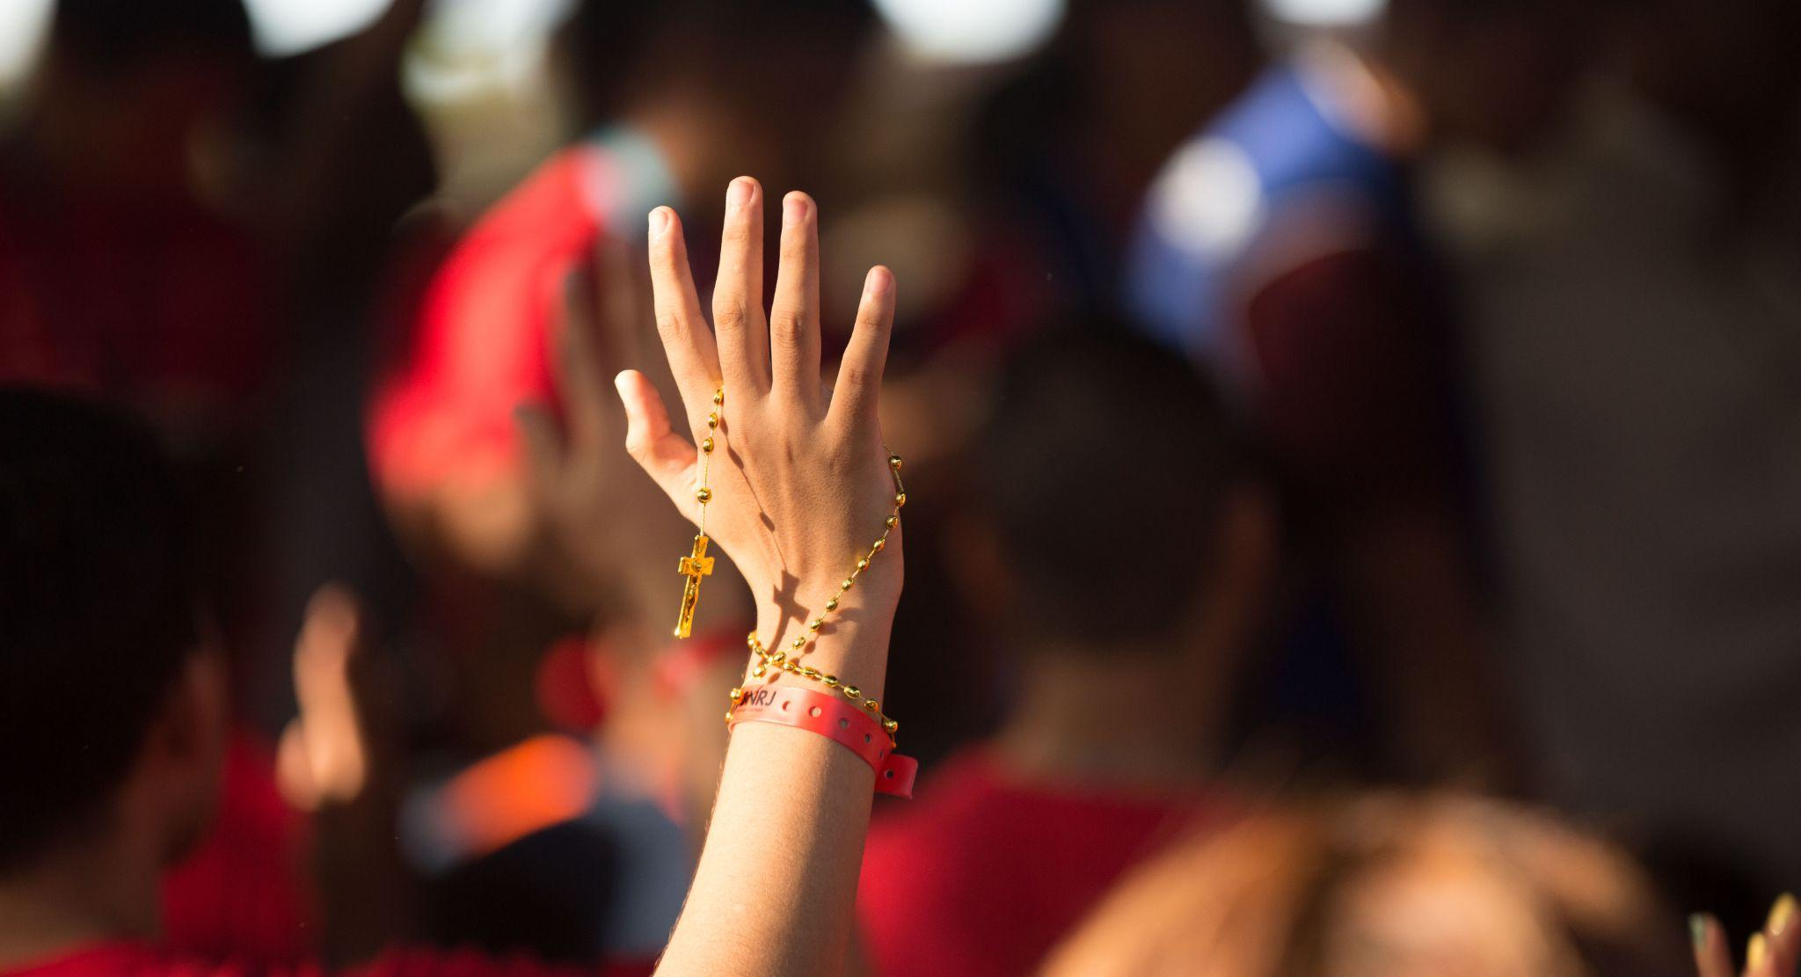
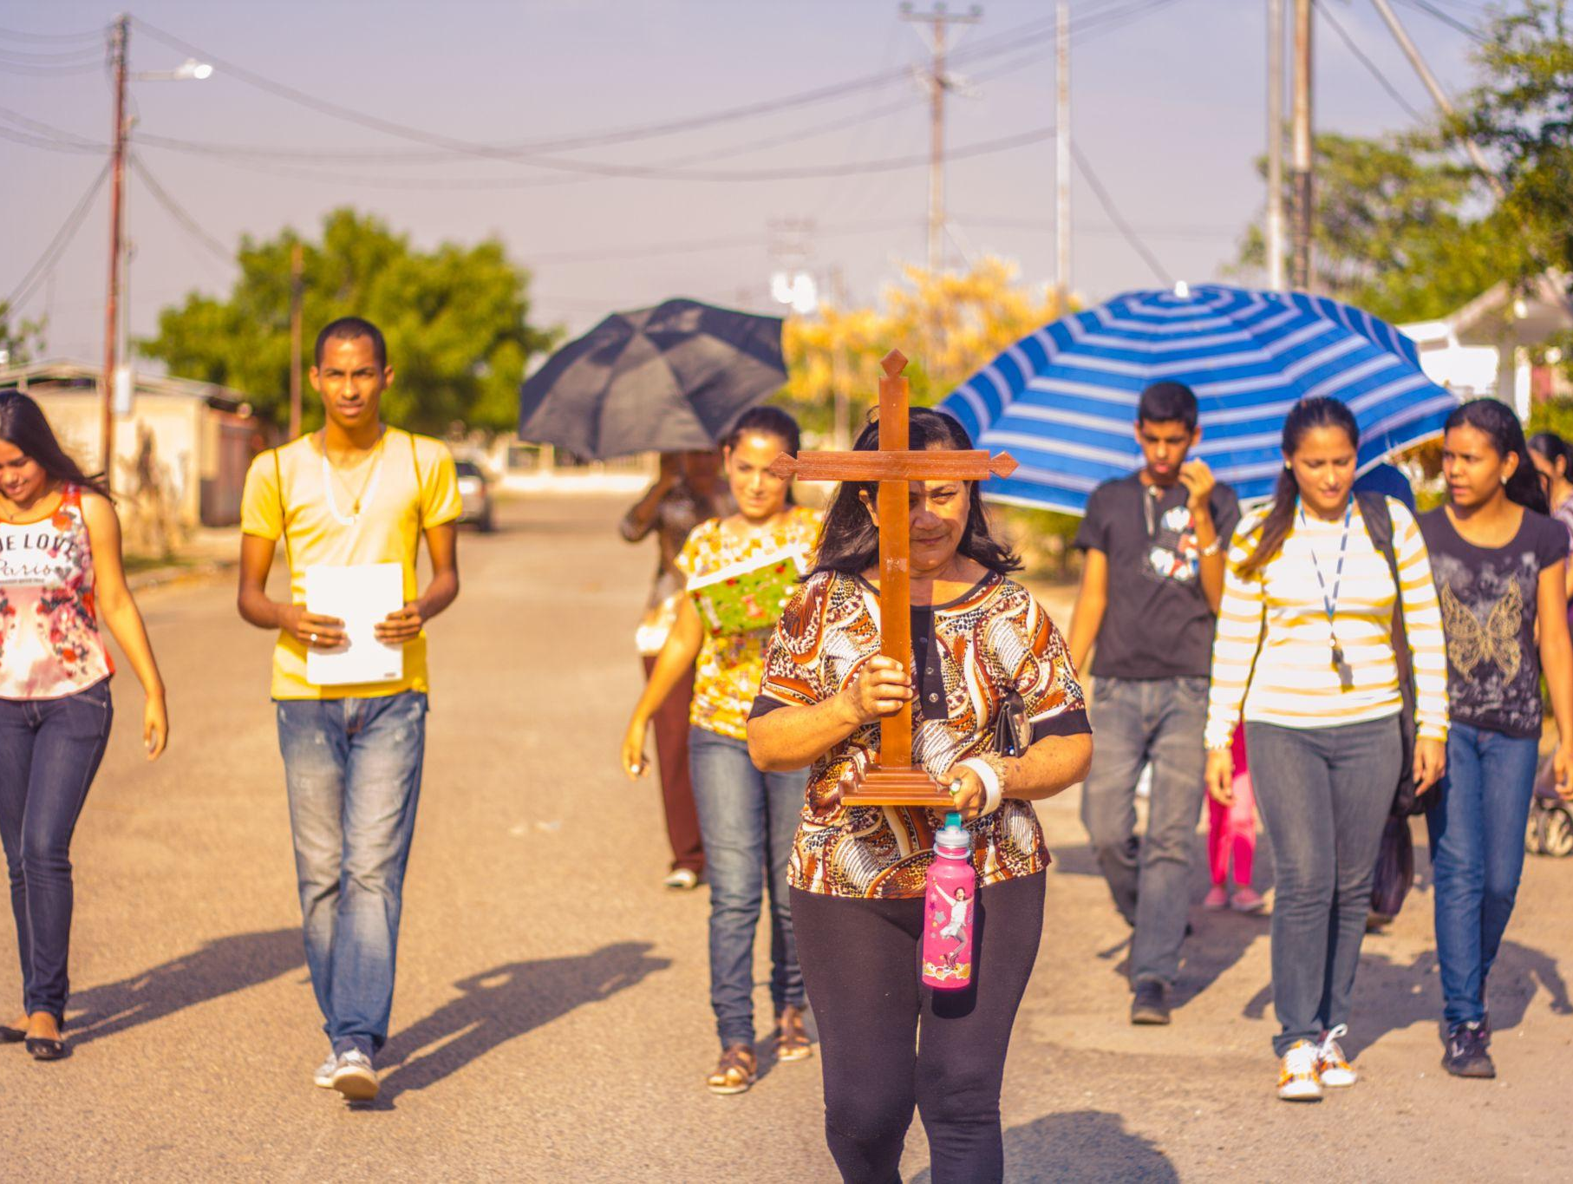
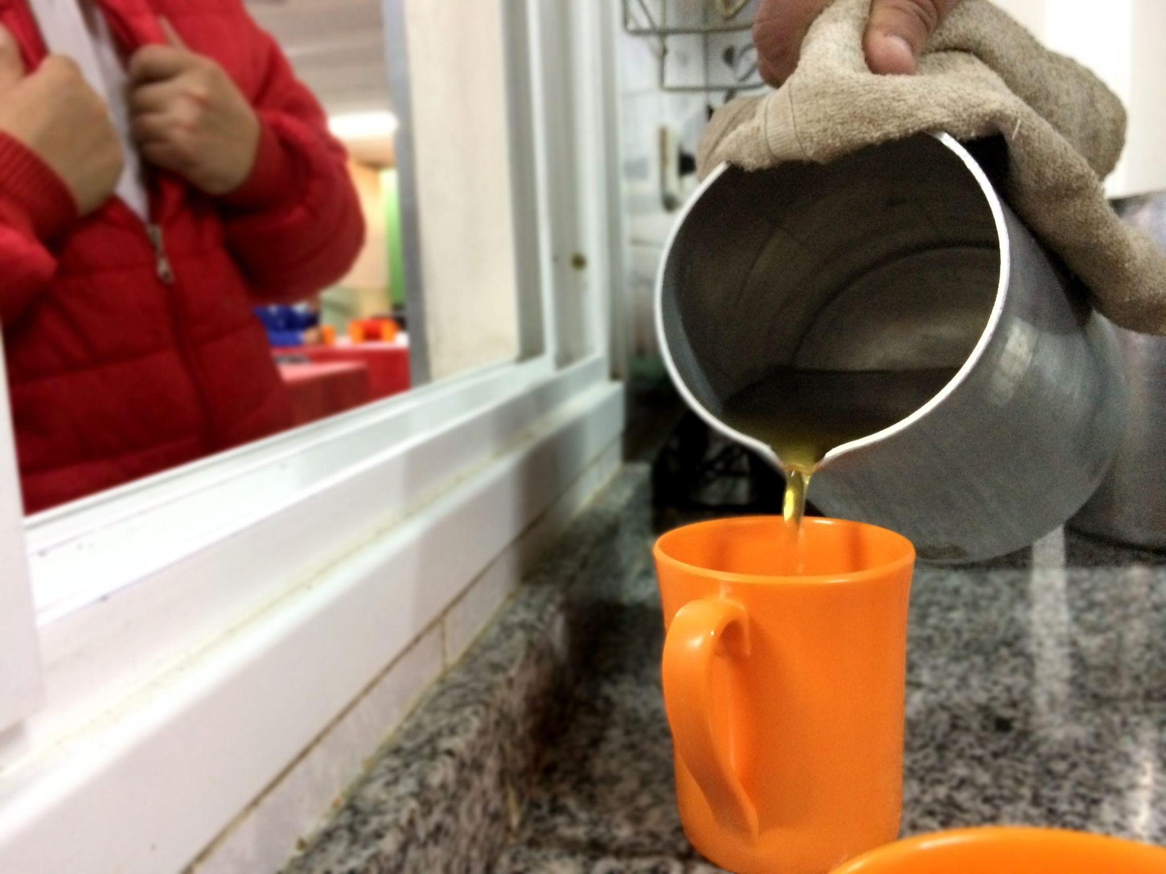
Key convictions for a Synodal Church
Listen to one another in order to listen to the Holy Spirit
In a spirit of prayer, grounded in the liturgy and the Word of God
An experience shared with one another, not just filling out a questionnaire
A process, not a one-time event
Discerning together so that the decisions made are for the good of all

Slide 6
The Challenge of Synodality
“What the Lord is asking of us is already in some sense present in the very word “Synod.” Journeying together – laity, pastors, the Bishop of Rome – is an easy concept to put into words, but not so easy to put into practice.”
Pope Francis, Address at the Ceremony Commemorating the 50th Anniversary
of the Institution of the Synod of Bishops,
October 17 2015
Notes:
http://www.vatican.va/content/francesco/en/speeches/2015/october/documents/papa-francesco_20151017_50-anniversario-sinodo.html
We must continue along this path. The world in which we live, and which we are called to love and serve, even with its contradictions, demands that the Church strengthen cooperation in all areas of her mission. It is precisely this path of synodality which God expects of the Church of the third millennium. (Pope Francis, Address at the Commemoration of the 50th Anniversary of the Institution of the Synod of Bishops) * * *
“What the Lord is asking of us is already in some sense present in the very word “Synod.” Journeying together – laity, pastors, the Bishop of Rome – is an easy concept to put into words, but not so easy to put into practice.” (Pope Francis, Address at the Commemoration of the 50th Anniversary of the Institution of the Synod of Bishops)

Slide 7
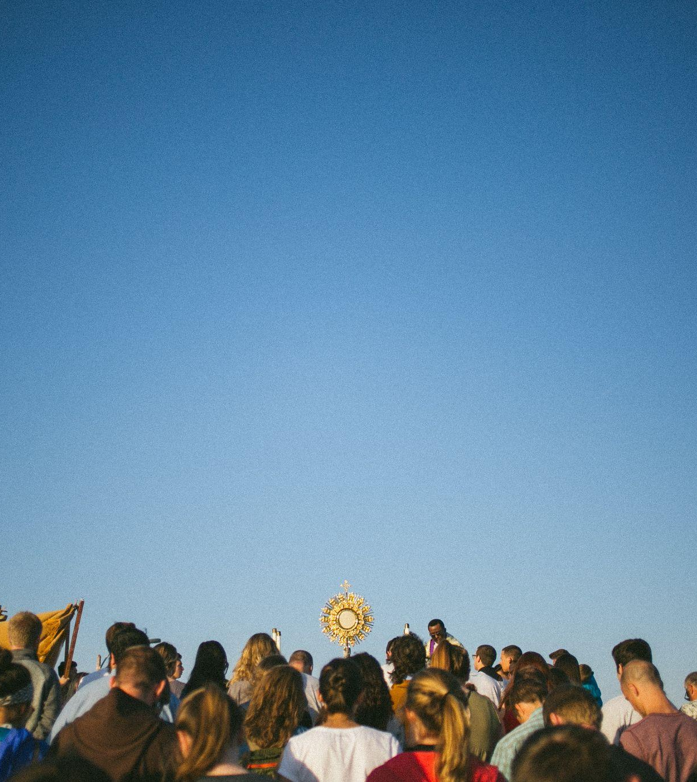
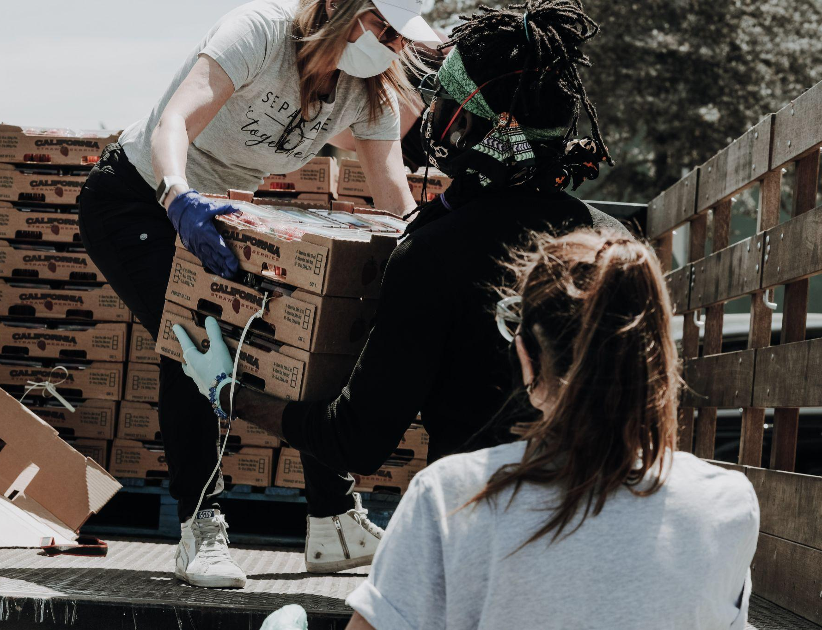
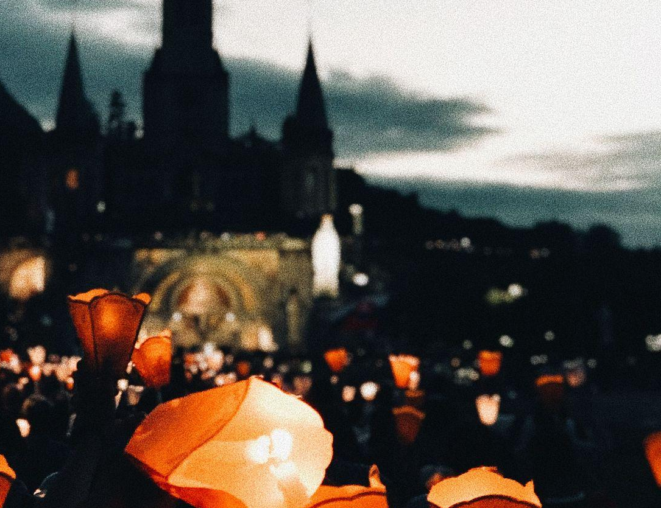
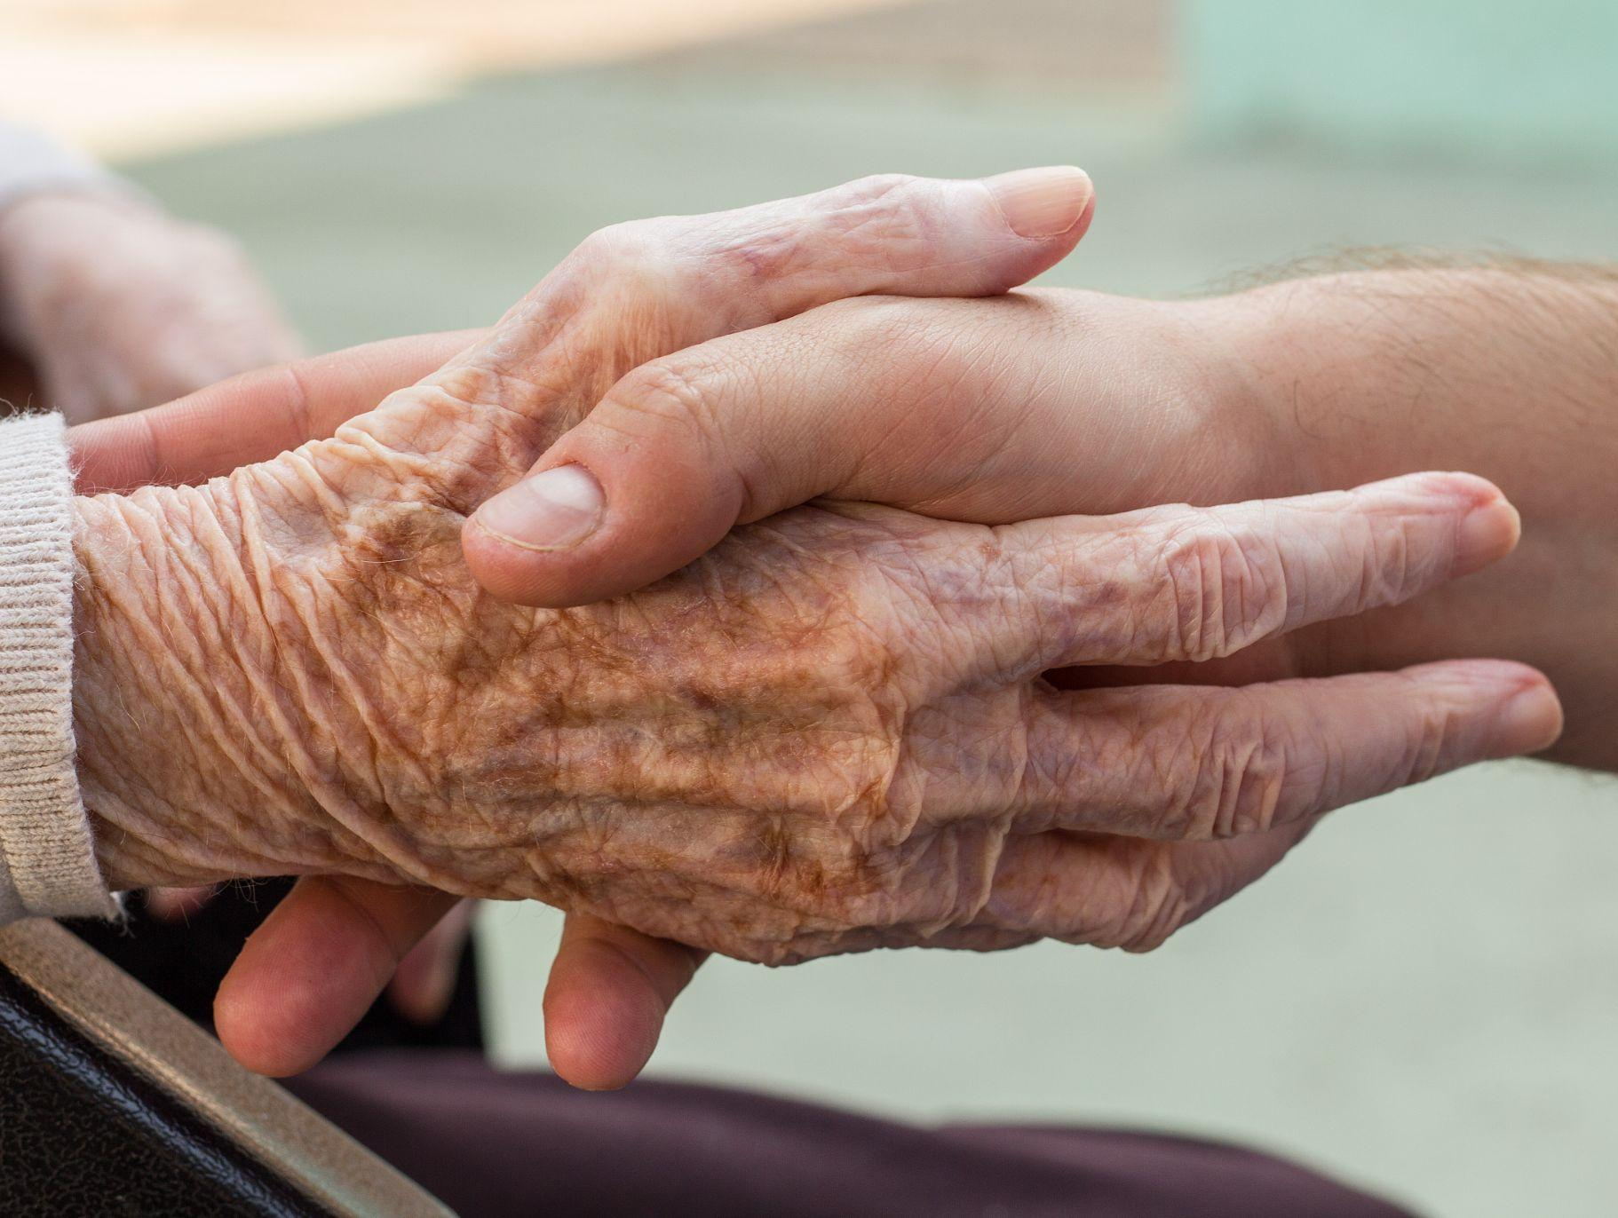
“The purpose of the Synod, and therefore of this consultation, is not to produce documents, but “to plant dreams, draw forth prophecies and visions, allow hope to be nourished, inspire trust, bind up wounds, weave together relationships, awaken a dawn of hope, learn from one another, and create a bright resourcefulness that will enlighten minds, warm hearts, give strength to our hands.”
(PD, 32)

Slide 8
The Objectives of the Synod (PD, 2)
recalling how the Spirit has guided the Church’s journey through history and, today, calls us to be, together, witnesses of God’s love;
living a participative and inclusive ecclesial process that offers everyone—especially those who for various reasons find themselves on the margins—the opportunity to express themselves and to be heard in order to contribute to the edification of the People of God;
recognizing and appreciating the wealth and the variety of the gifts and charisms that the Spirit liberally bestows for the good of the community and the benefit of the entire human family;
exploring participatory ways of exercising responsibility in the proclamation of the Gospel and in the effort to build a more beautiful and habitable world

Slide 9
The Objectives of the Synod (PD, 2)
examining how responsibility and power are lived in the Church as well as the structures by which they are managed, bringing to light and trying to convert prejudices and distorted practices that are not rooted in the Gospel
accrediting the Christian community as a credible subject and reliable partner in paths of social dialogue, healing, reconciliation, inclusion and participation, the reconstruction of democracy, the promotion of fraternity and social friendship
regenerating relationships among members of Christian communities as well as between communities and other social groups, e.g., communities of believers of other denominations and religions, civil society organizations, popular movements, etc
fostering the appreciation and appropriation of the fruits of recent synodal experiences on the universal, regional, national, and local levels

Slide 10
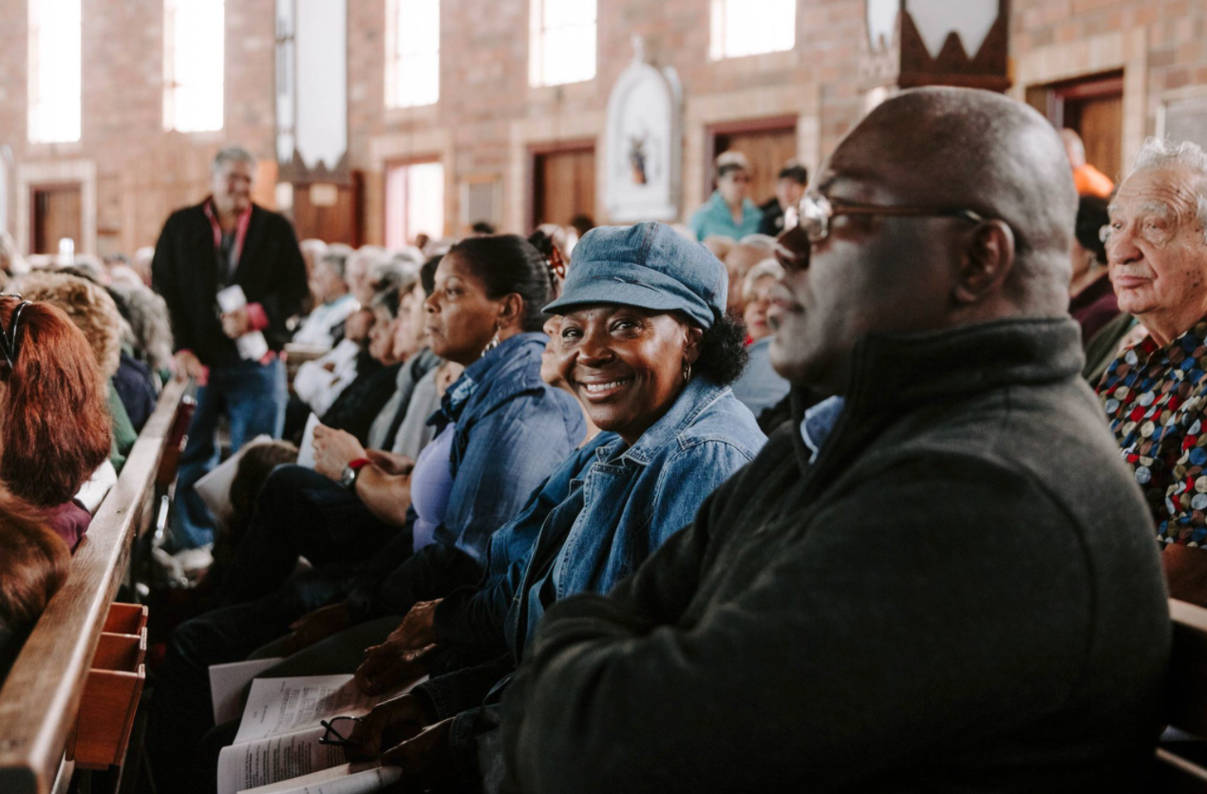

Slide 11
Discerning the signs of the times in the light of the Gospel
“The synodal journey unfolds within a historical context marked by epochal changes in society and by a crucial transition in the life of the Church, which cannot be ignored: it is within the folds of the complexity of this context, in its tensions and contradictions, that we are called to ‘scrutinize the signs of the times and interpret them in the light of the Gospel’ (GS, 4).”
(PD, 4)
The global tragedy of the COVID-19 pandemic
Inequalities and injustices: massification, fragmentation, the conditions faced by migrants, divisions across the family of humanity
The cry of the poor and the cry of the earth
We are all in the same boat…We are one human family living in our common home.
(Laudato Si’ and Fratelli Tutti)

Slide 12
“Within this context, synodality represents the main road for the Church,called to renew herself under the action of the Spirit and by listening to the Word.” (PD, 9)
Imagining a different future for the Church
Being a prophetic witness to the human family, which needs to be united around a common goal

Slide 13
Ten Themes to Explore
DIALOGUE IN CHURCH AND SOCIETY: Dialogue is a path of perseverance that also includes silences and sufferings, but which is capable of gathering the experience of persons and peoples.
ECUMENISM: The dialogue between Christians of different confessions, united by one baptism, has a special place in the synodal journey.
AUTHORITY AND PARTICIPATION: A synodal Church is a participatory and co-responsible Church.
DISCERNING AND DECIDING: In a synodal style, decisions are made through discernment, based on a consensus that flows from the common obedience to the Spirit.
FORMING OURSELVES IN SYNODALITY: The spirituality of journeying together is called to become an educational principle for the formation of the human person and of the Christian, of the families, and of the communities.
COMPANIONS ON THE JOURNEY: In the Church and in society, we are side by side on the same road.
LISTENING: Listening is the first step, but it requires having an open mind and heart, without prejudice.
SPEAKING OUT: All are invited to speak with courage and parrhesia, that is, integrating freedom, truth, and charity.
CELEBRATION: “Journeying together” is only possible if it is based on communal listening to the Word and the celebration of the Eucharist.
SHARING RESPONSIBILITY FOR OUR COMMON MISSION: Synodality is at the service of the mission of the Church, in which all members are called to participate.

Slide 14
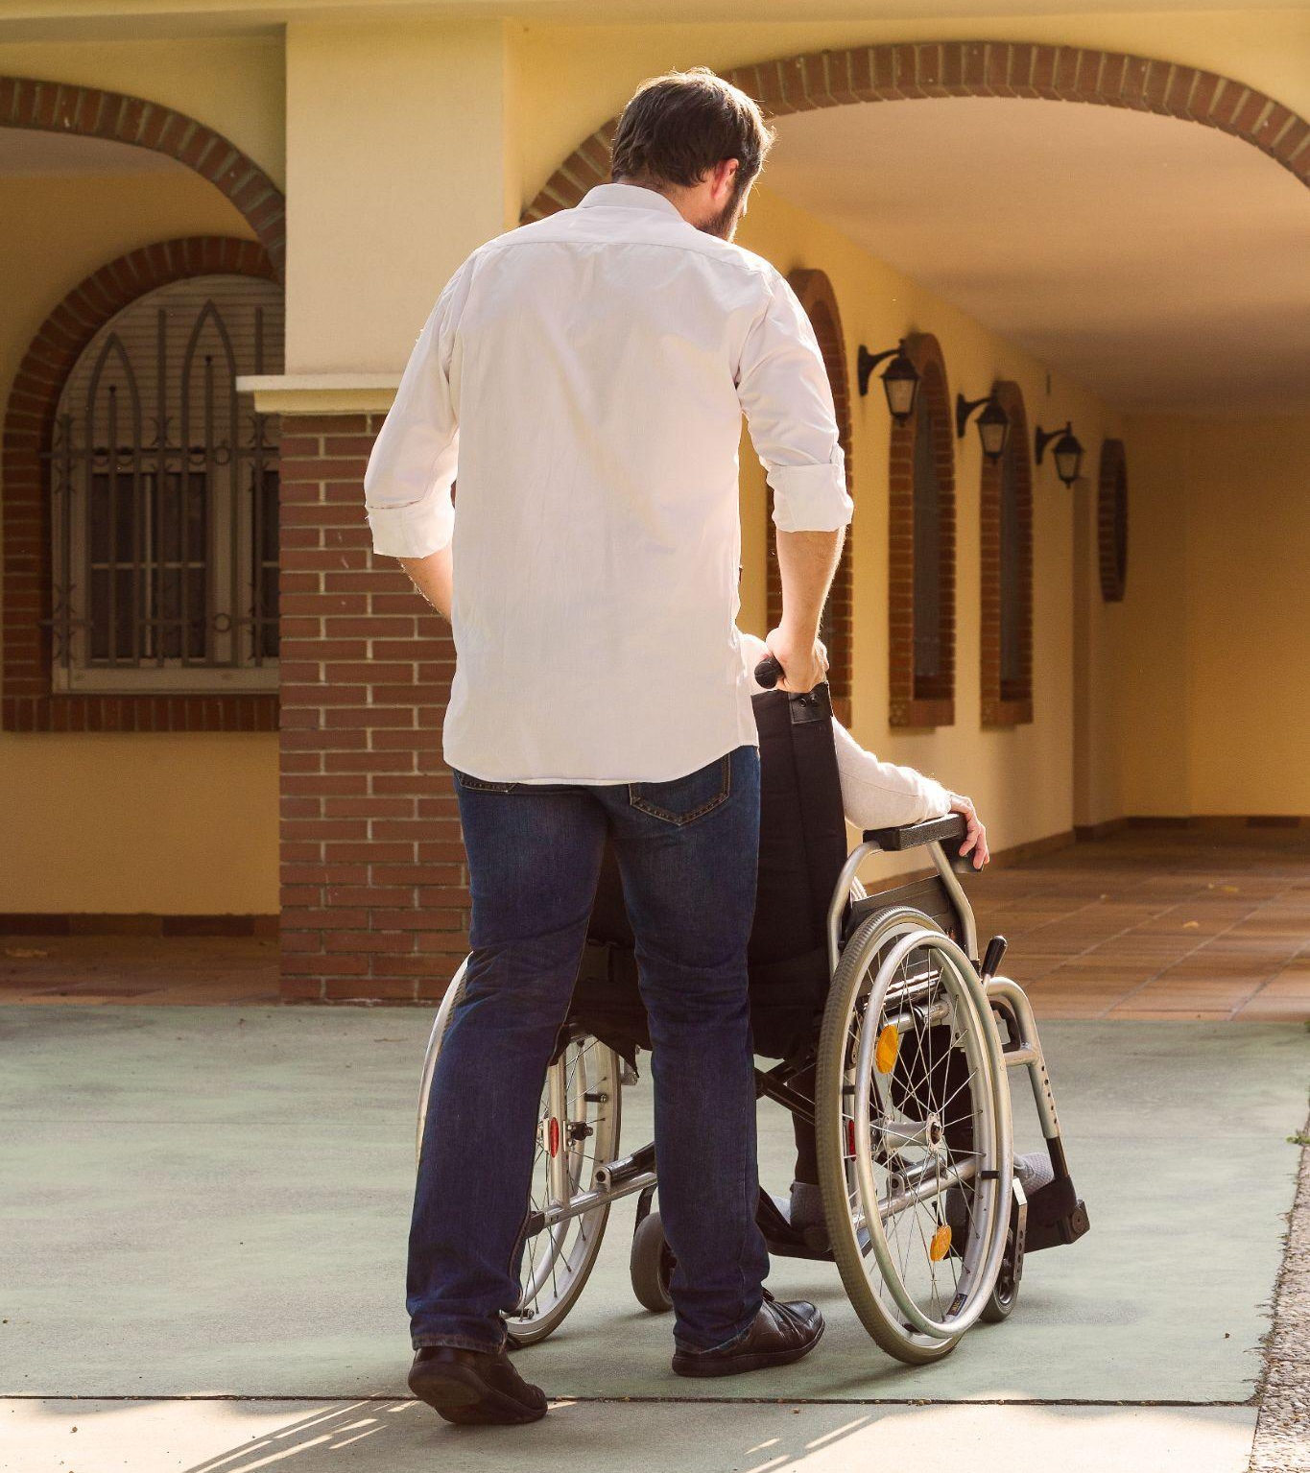
FOSTERING WIDE PARTICIPATION IN THE SYNODAL PROCESS
The goal is to ensure the participation of the greatest number possible, in order to listen to the living voice of the entire People of God.
This is not possible unless we make special efforts to actively reach out to people where they’re at, especially those who are often excluded or who are not involved in the life of the Church.
There must be a clear focus on the participation of the poor, marginalized, vulnerable, and excluded, in order to listen to their voices and experiences.
The Synodal Process must be simple, accessible, and welcoming for all.

Slide 15
The Diocesan Phase of the Synod
Dates: From 7 October 2021 to 15 August 2022
Objectives: Consultation of the People of God: to listen, participate, discern
How the consultation should be carried out:
  Honestly: the People of God are truly consulted
  As broadly as possible: everyone participates, including those on the margins
  Practical: provides concrete help for the mission to evangelize
Aids for the Diocesan Phase:
  Synodal Team coordinating this consultation in each Diocese
  Diocesan Assembly at the end of the consultation for communal discernment

Slide 16
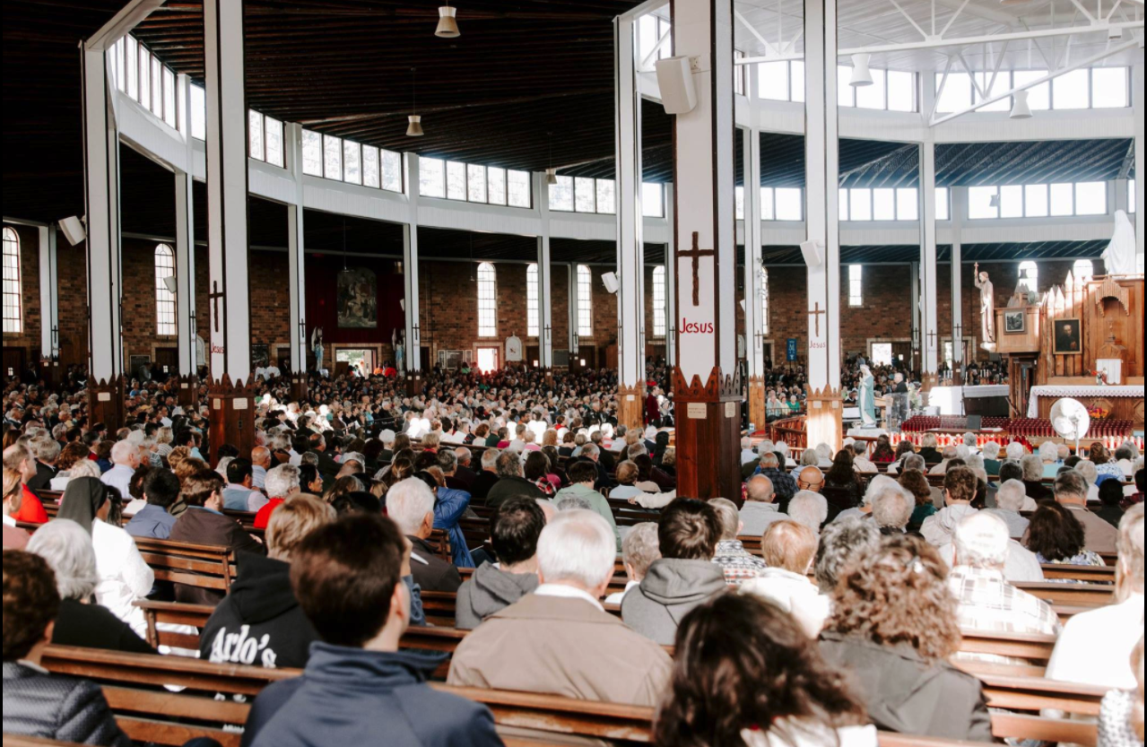
“We are here for one another.
We are here to come together.
We are here to pray for one another.”
— Bishop Scharfenberger

Slide 17


